Slide 1
Week 8 Assignment
Localization and Navigation

Slide 2
Mapping with Cartographer
Launch the SLAM node.
Adjust parameters in the .lua file to tune the map
In this case adjusting min and max range of the lidar had the most effect on the map. Shortening the distance created a map that could be navigated cleanly by the robot.

Slide 3
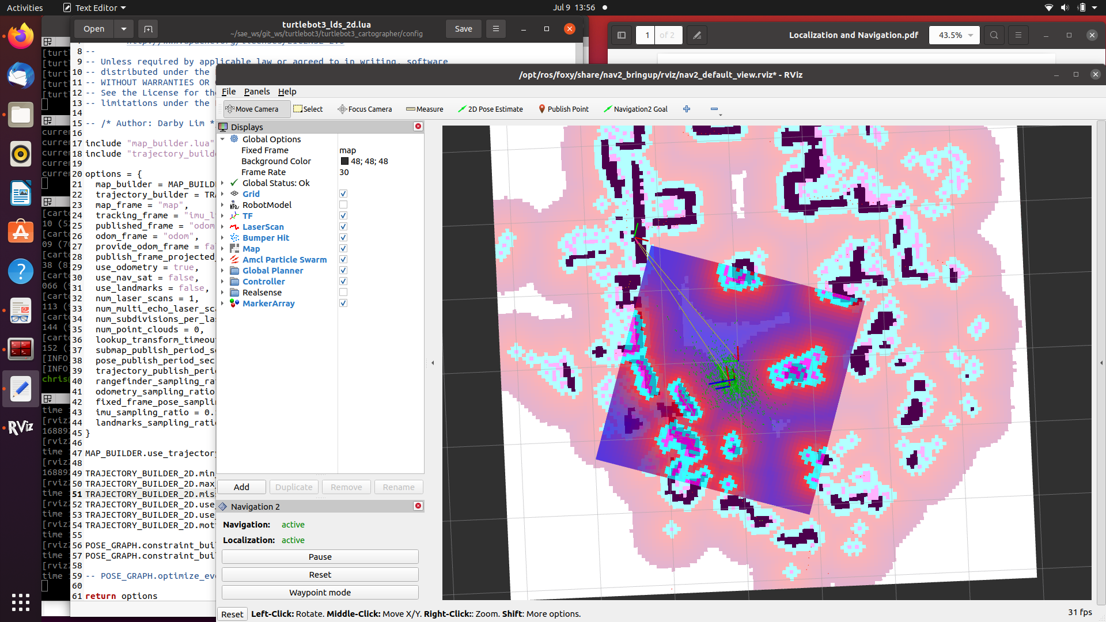
Localization with AMCL
I didn’t get a really tight convergence but it was enough to enable the robot to work.
I did adjust the number of particles and that may have helped.

Slide 4
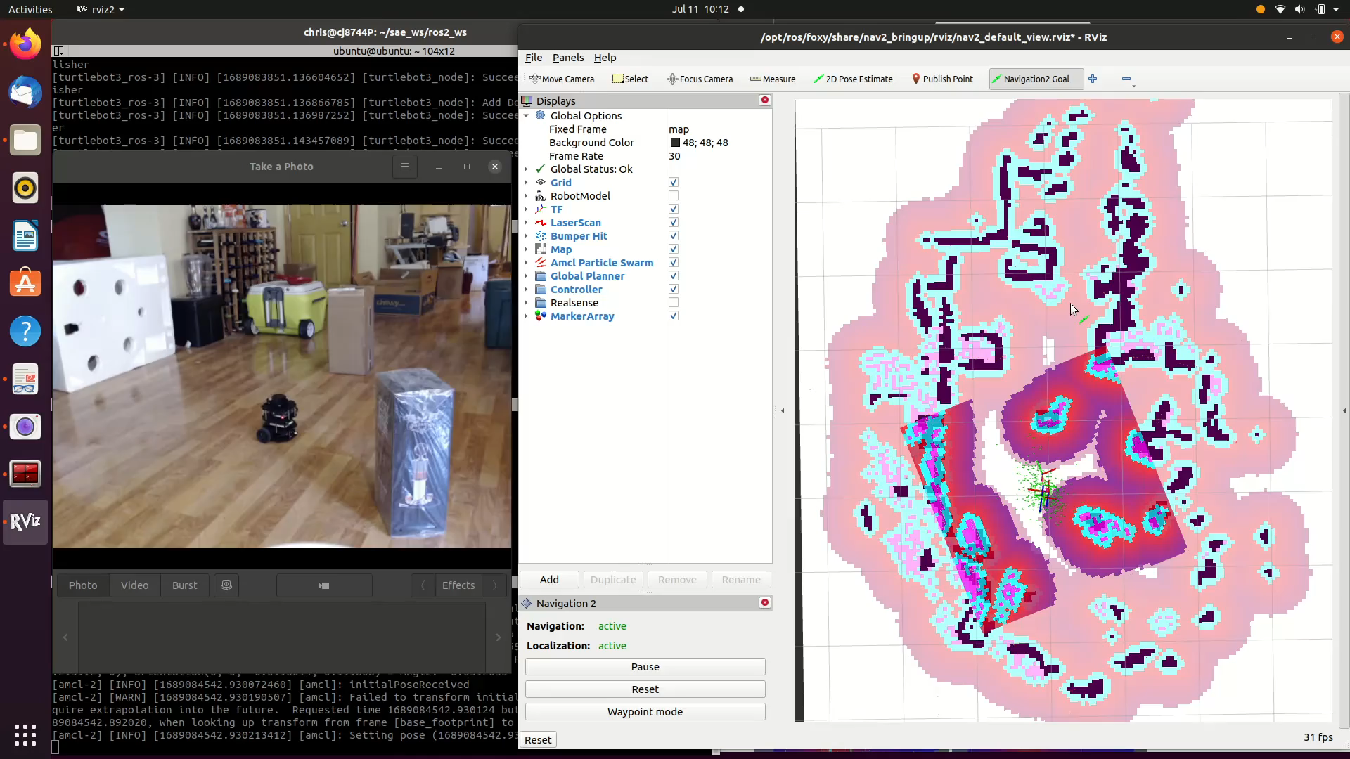
Navigation
The robot successfully navigated to the goal (press play).

Slide 5
Response to Assignment Questions

